Slide 1



IBM INTERNSHIP
Salary Prediction Using Regression
Artificial Intelligence Based Machine Learning Project
Presented by : KARAN SINGH
Course : Artificial Intelligece
KARAN SINGH

Slide 2

INTRODUCTION
What is Salary Prediction?
Salary prediction is the process of estimating an employee's salary based on various factors such as years of experience, education level, skills, job role, and location. Organizations often need reliable methods to determine fair and competitive salaries for employees.
Companies want to estimate salaries based on experience and skills.
Machine learning helps predict salary using past data.
KARAN SINGH

Slide 3

Problem Statement
Predict employee salary using regression based on years of experience.
Salary estimation is often done manually and may be inaccurate.
Organizations need a data-driven method to predict employee salaries.
Predicting salary based on experience and historical data can improve decision making.
This project uses regression techniques to predict salary efficiently.
KARAN SINGH

Slide 4
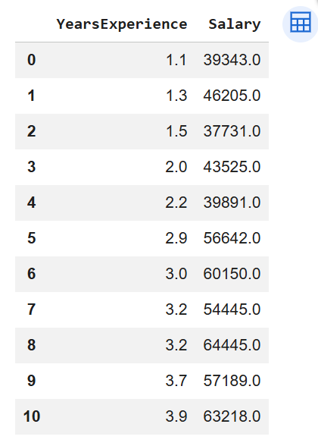
Dataset
Dataset Explanation
The dataset contains employee experience and salary information.
YearsExperience: Number of years an employee has worked.
Salary: Annual salary received by the employee.
This data is used to train a regression model to predict salary based on experience.
KARAN SINGH

Slide 5

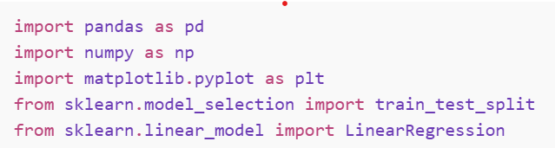
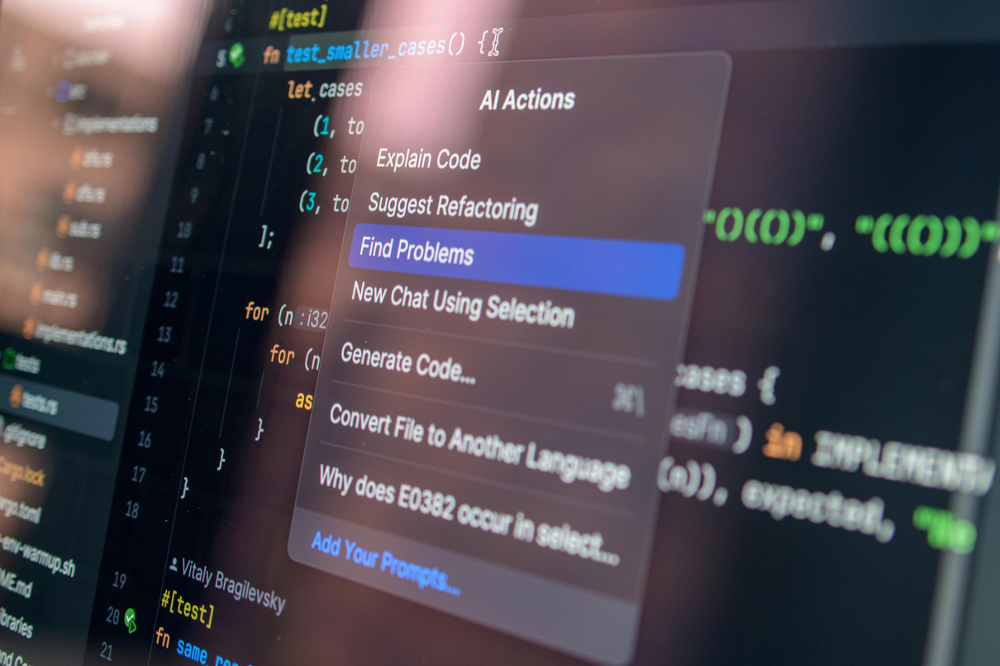
Technologies Used
Python
Pandas
NumPy
Scikit-learn
Matplotlib
KARAN SINGH

Slide 6

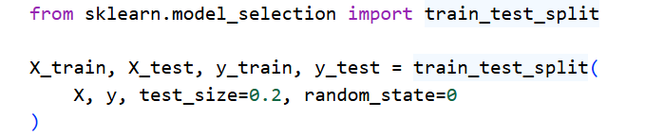
Methodology
KARAN SINGH
The methodology describes the process used to build the salary prediction model using machine learning.
Steps involved in the project :
Data Collection
The salary dataset containing years of experience and salary values was collected.
2. Data Preprocessing
The dataset was checked for missing values and prepared for analysis.
3. Train-Test Split
The dataset was divided into training and testing sets to evaluate the model performance.

Slide 7


Model Training
A Linear Regression algorithm was used to train the model and learn the
relationship between experience and salary.
5. Prediction and Evaluation
The trained model predicts salaries based on experience, and its accuracy is
evaluated using performance metrics.
KARAN SINGH

Slide 8
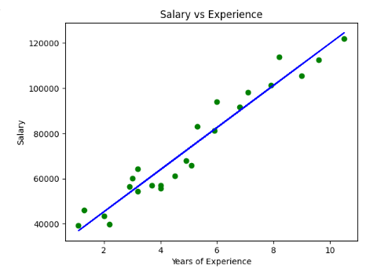
Data Visualization
A scatter plot is used to visualize the relationship between experience and salary.
The graph shows that salary increases as experience increases.
This indicates a positive linear relationship between the variables.
Therefore, Linear Regression can be used for salary prediction.
KARAN SINGH

Slide 9
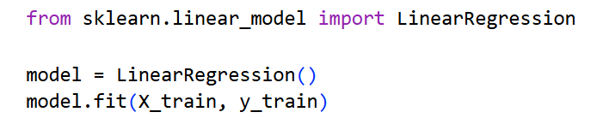
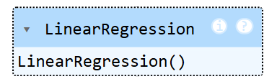
KARAN SINGH
Model Used: Linear Regression
Linear Regression is used to predict salary based on experience.
It finds the best-fit line between experience and salary.
The model learns from historical data and predicts salary for new inputs.

Slide 10

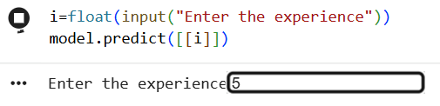

Results
The Linear Regression model successfully predicted salaries based on experience.
Predicted values were close to the actual salary values.
The regression line shows a positive relationship between experience and salary.
This indicates that the model performs well for salary prediction.
Output
Code , Input = 5
KARAN SINGH

Slide 11
Conclusion
This project shows that regression models can analyze factors like experience to predict salary. It demonstrates how machine learning can be used to make accurate and data-driven predictions.
The model achieved an accuracy of around 98%, demonstrating that machine learning can provide reliable insights for salary estimation.
KARAN SINGH

Slide 12
KARAN SINGH
Thank
You
For your Time and Attention
482KARAN@GMAIL.COM
-
WWW.KARAN1901.INFO

